Slide 1

Category Code: C3
Problem Statement Title:Creating an all-in-one platform for startups, simplifying financial planning for new enterprises, and seamlessly connecting investors with SMBs
Team Name: Job Blowers
Institute Name: Vivekanand Education Society’s Institute of Technology

Slide 2








Idea / Approach details
Problem Statement
Our Proposed Solution
Finsight AI
Your New Financial
Co-Founder
FinsightAI is an AI-powered platform that simplifies financial planning for startups and connects them with the right investors.
It provides data-driven loan recommendations, cash flow management, stock optimization, and credit risk analysis, ensuring startups make informed financial decisions.
With AI-driven investor matchmaking, real-time market insights, and automated financial planning tools, startups can optimize growth while investors gain access to transparent, high-potential opportunities.
By leveraging predictive analytics, smart recommendations, and real-time alerts, FinsightAI enhances financial stability, investment success, and business growth in a rapidly evolving market.
Overwhelmed by fluctuating revenue and unclear loan terms, Rohan is unsure how to secure funding.
Frustrated by a lack of financial transparency, Nirmala struggles to find promising startups.
Rohan uses the platform to receive personalized loan suggestions, cash flow strategies, and investor matches.
Nirmala accesses AI-driven financial reports, helping her discover trustworthy startups to invest in.
Rohan secures funding, Nirmala makes a profitable investment, and the platform bridges the funding gap.
Notes:
1.7.2013
‹#›

Slide 3

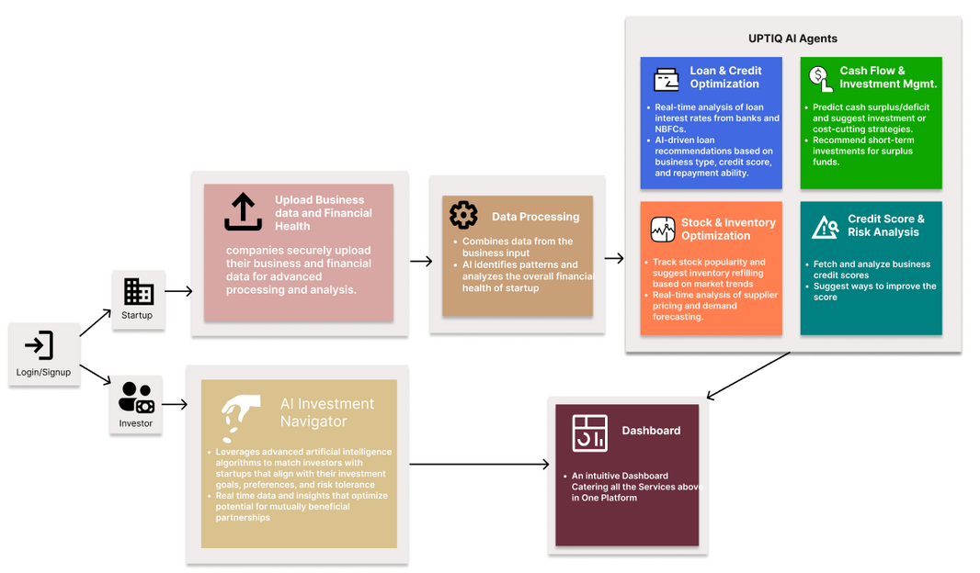
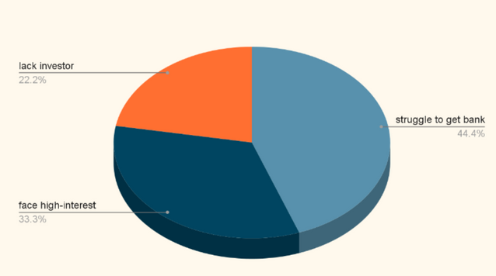
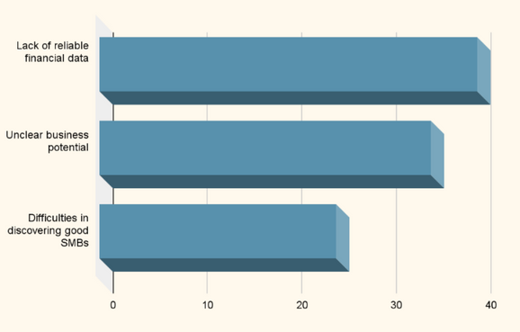
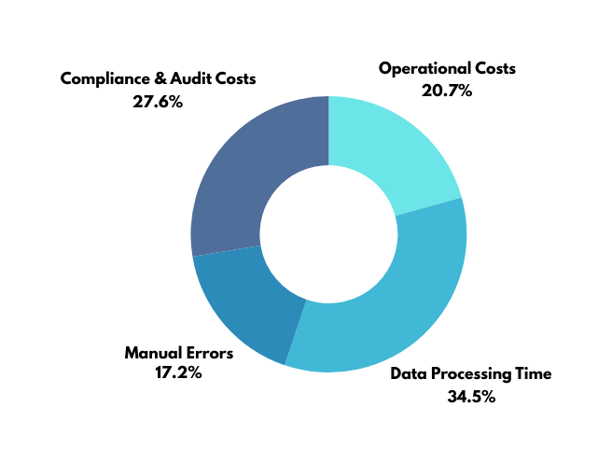
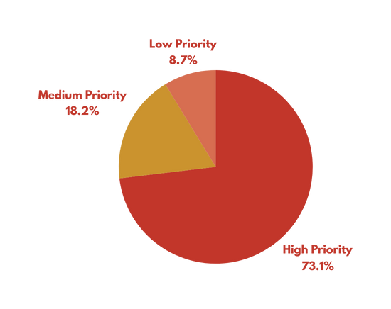
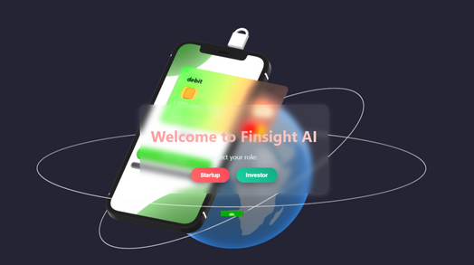
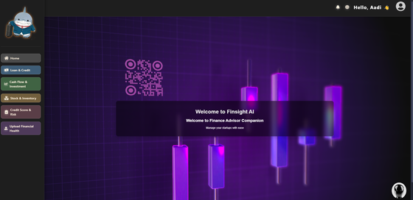
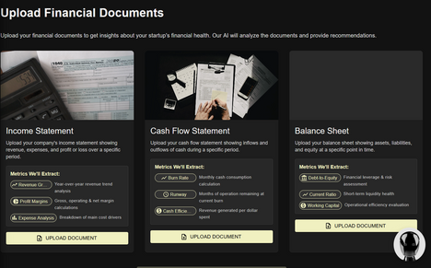
Implementation/Prototype/Use Case Diagram (screenshots)
FLOWCHART
WHATS THE NEED OF OUR PLATFORM??
Struggles Start Up Face related to Financial Health
Struggles Investors Face
Research:
Tipalti
PROJECT SCREENSHOTS
finlogic.io
Cost Reduction Through Automation in Financial Analysis
Preference for Automation Investment by Financial Professionals
Notes:
1.7.2013
‹#›

Slide 4
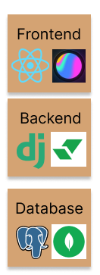


Tech Stack
Connects startups and investors
Ai-driven insights for better decision-making
Helps startups plan effectively
Meeting the rising demand for funding solutions.
Partnerships with banks and other financial institutions.
S
O
SWOT
W
Earning credibility among users.
Compliance with financial laws
Highly accurate data needed for reliability.
Competition from other fintech apps.
Risk of data breaches.
T
Notes:
1.7.2013
‹#›

Slide 5

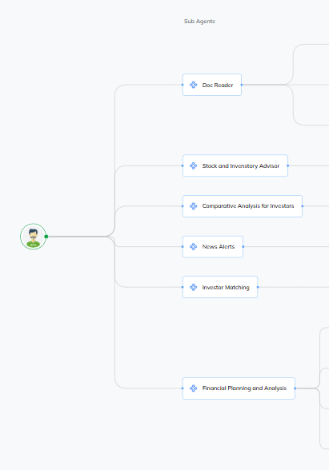
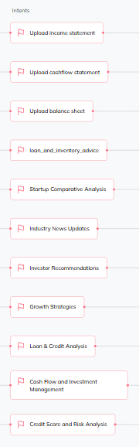
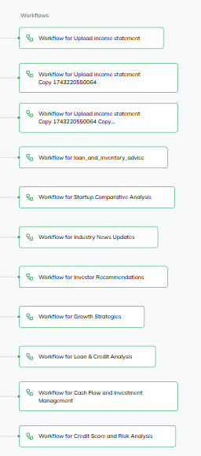
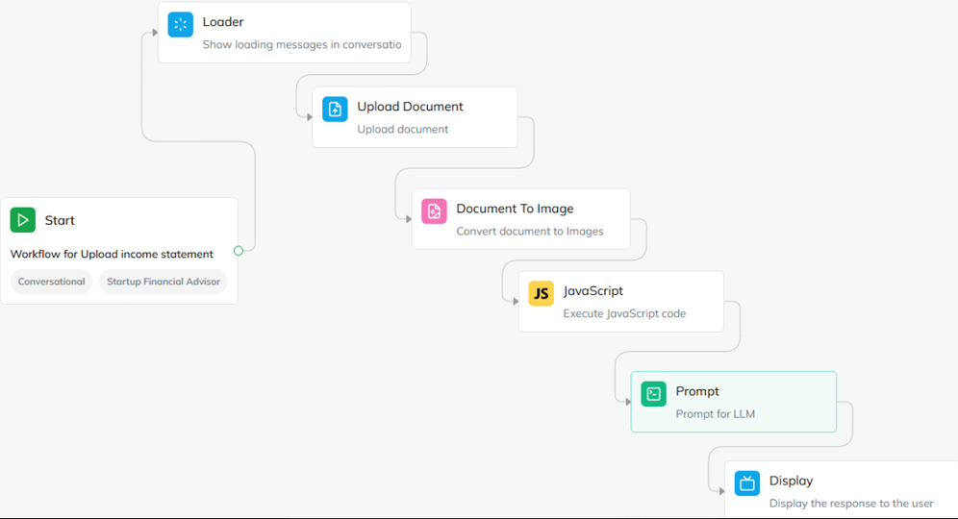
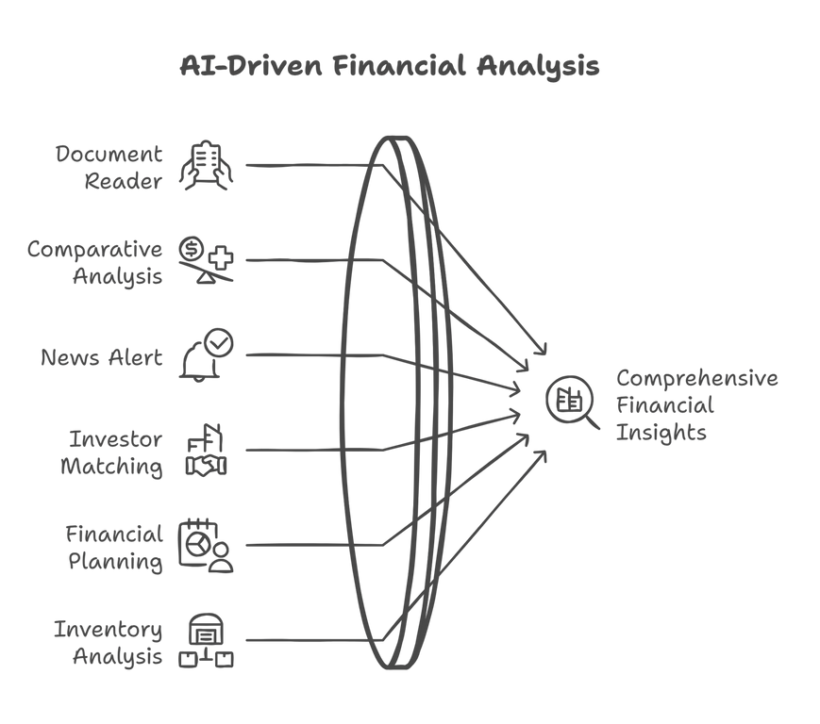
Innovation
Overview of the Agent
Sub-Agent 1 :Document Reader
Aim of Sub-Agent: To Read the Documents And Extract important Financial Metric from it
There are actually 3 sub agents derived from this:
1) Income Statement Reader
2) Cash Flow Statement Reader
3) Balance Sheet Reader
Workflow
It Extracts Valuabe FInancial Metrics from those following Documents
Example Of Metrics Extracted -
Gross Profit Margin
EBITA
Net Profit Margin
Total Revenue
AI AGENT DIAGRAM
Notes:
1.7.2013
‹#›

Slide 6
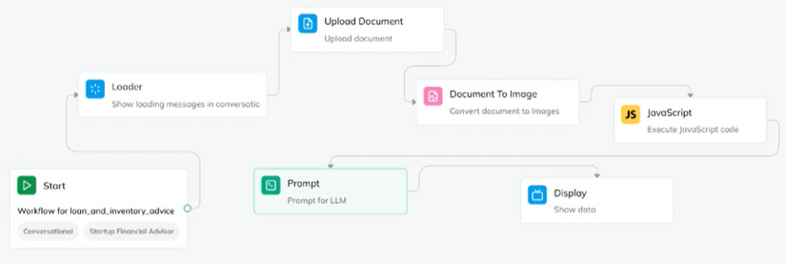
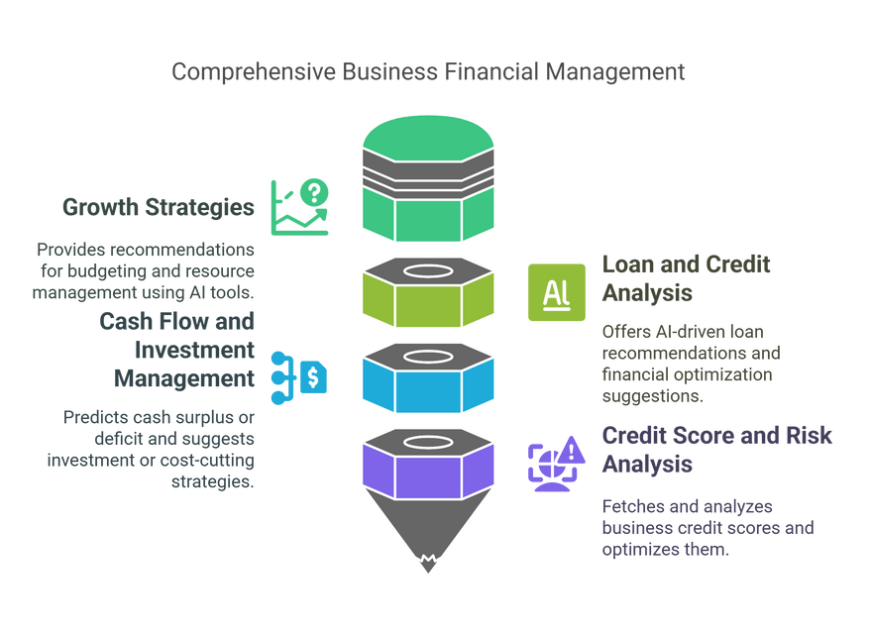
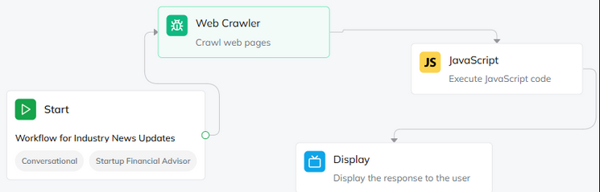
Demo Video Link & Sub Agents
Sub-Agent 2 :Inventory and Stock Analysis
Sub-Agent 3 :Financial Planning and Analysis
Sub-Agent 4 :News Alert
Aim: Tracks stock popularity and suggests inventory refilling based on market trends
Aim : To give Financial Planning and Analysis
Aim : To Give News Alerts of Competetive Rivals of a Buisness
Workflow
Intents Of Sub Agent
Workflow
It analyzes the Metrics and gives suggestions on stock / inventory refilling based on market trends
It WebScrapes The Websites by WebCrawler Node and gives every news relevant to the startups domain and industry
Metrics it uses
Inventory Turnover Ratio
Days Inventory Outstanding
Stock-to-Sales Ratio
GMROI
Reorder Point (ROP)
(EOQ)
DEMO VIDEO LINK
https://youtu.be/jFWeJsk8u98

Slide 7

Future Scope
Blockchain powered funding and compliance
Seamless Workflow Integration
Give Real-Time Investor Insights
Pitch Deck
Investors and startups can communicate, schedule meetings, track progress,and share documents effortlessly
Crunchbase and Traxcn API’s being Exclusive users only
Smart contracts for secure, automated, and transparent funding.
Pitch Deck that provides insights into presentations and financial overciews for investors

